Slide 1






SYG DAYS
DIGITAL PEDAGOGY IN INCLUSIVE EDUCATION
4TH MARCH 2023
Prepared and presented by Zdravka Majkić

Slide 2




WHAT IS DIGITAL PEDAGOGY?
WIKIPEDIA
DICTIONARY SEARCH
Digital pedagogy is the study and use of contemporary digital technologies in teaching and learning. Digital pedagogy may be applied to online, hybrid, and face-to-face learning environment.
The process of using digital technologies in the teaching and learning process is known as digital pedagogy.

Slide 3





DICTIONARY
the action or state of including or of being included within a group or structure.
WIKIPEDIA
WHAT IS INCLUSION?
Inclusion in education refers to all students being able to access and gain equal opportunities to education and learning.
SEARCH ENGINE
Inclusion is an organisational effort and practices in which different groups or individuals having different backgrounds are culturally and socially accepted and welcomed.

Slide 4


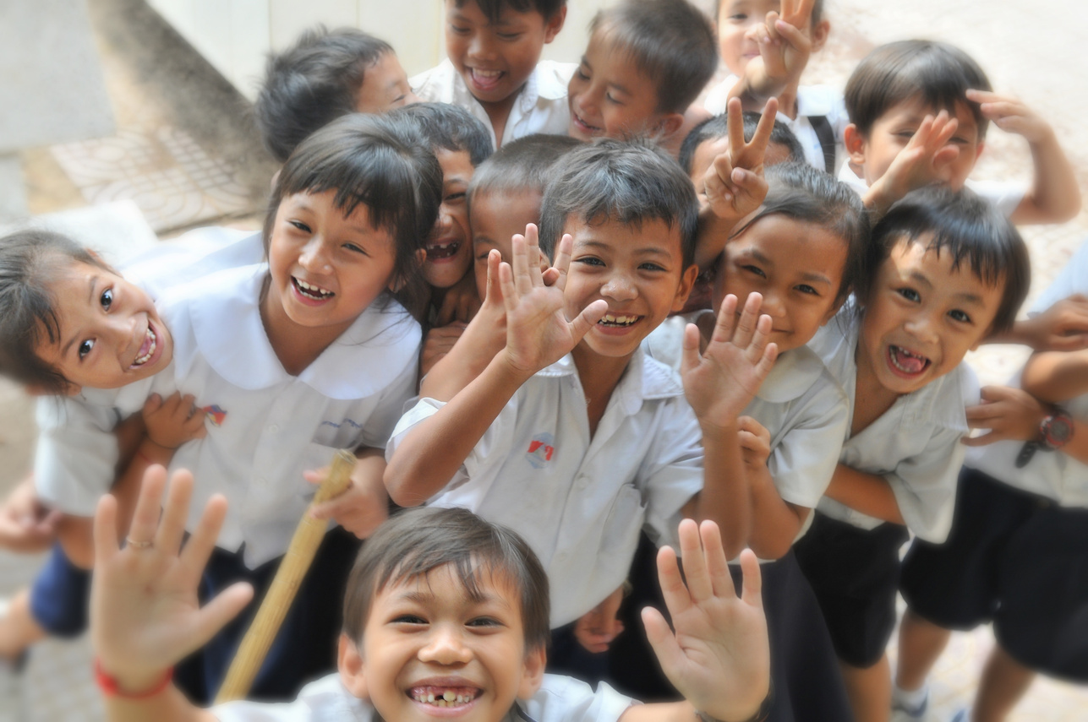




THERE IS NO AGE LIMIT
mental or phiyscal activity bariers
INCLUSION IS SENSE OF BELONGING!
WHEREVER YOU ARE
social cultural and psychological barriers

Slide 5




TYPES OF INCUSION
INCLUSIVE EDUCATION
also called inclusion – is education that includes everyone, with non-disabled and Disabled people (including those with “special educational needs”) learning together in mainstream schools, colleges and universities
SOCIAL INCLUSION
  is the process of improving the terms on which individuals and groups take part in society

Slide 6




WHAT IS INCLUSION?
AND SOCIAL INCLUSION ?
This means the system must adapt to include Disabled people – they should not have to adapt to the system . The education system must recognise that it creates barriers for Disabled learners, for instance if parts of the school are inaccessible. Disabled pupils and students may require adaptations and support to access the curriculum.
Disadvantage is often based on gender, age, location, occupation, race, ethnicity, religion, citizenship status, disability, and sexual orientation and gender identity (SOGI), among other factors. This kind of social exclusion robs individuals of dignity, security, and the opportunity to lead a better life.

Slide 7





WHAT CAN TEACHERS DO?

Slide 8


DIGITAL PEDAGOGY?
Learning and having fun are somehow seen as adversarial. But learning is not only a cognitive experience—it is also a social activity. We learn from and with each other. ‎ And the power of playing ‎cannot be overstated: We learn our first life lessons through ‎playing with our peers. And we can continue to learn through the power of fun games. We have to get rid of the notion that suffering is positively correlated with ‎learning—it is not. Especially with so many students struggling with loneliness, fostering a positive social atmosphere through games will facilitate an inclusive classroom environment.

Slide 9




GAMES
SOCIAL BARRIERS
ADHD SYNDROME
DYSLEXIA
digital flash cards
open close
team games

Slide 10



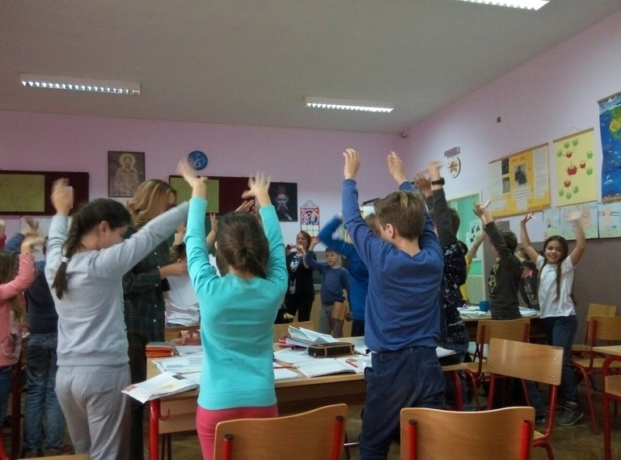
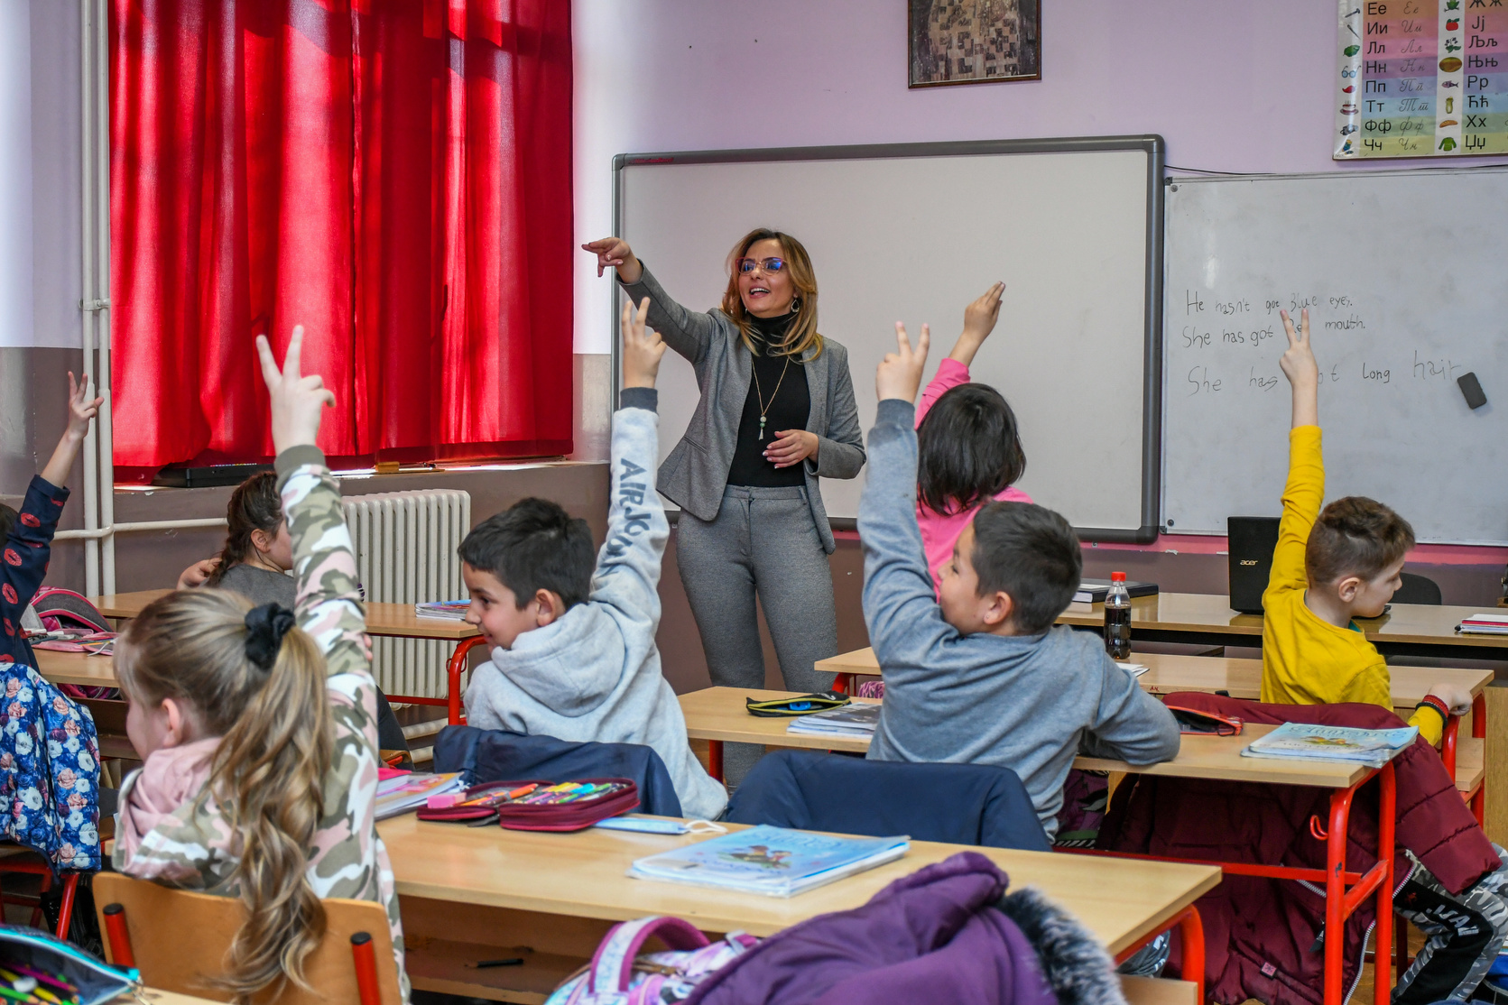
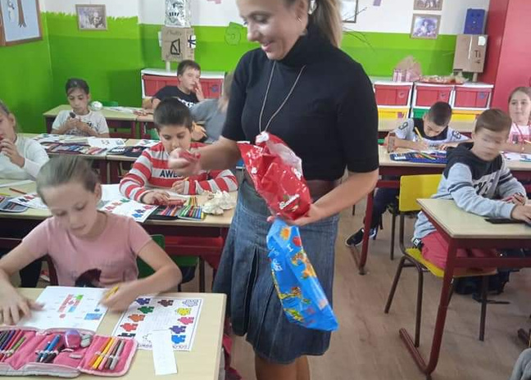



PHYSICAL CHARACTERISTICS
Use this space to describe how the character affects the plot.
EVERY CHILD HAS THE RIGHT TO QUALITY EDUCATION AND LEARNING

Slide 11


THANK YOU!
THANK YOU!
Do you have any follow-up questions for me?

